Slide 1
Heap
Full Binary Tree

Slide 2
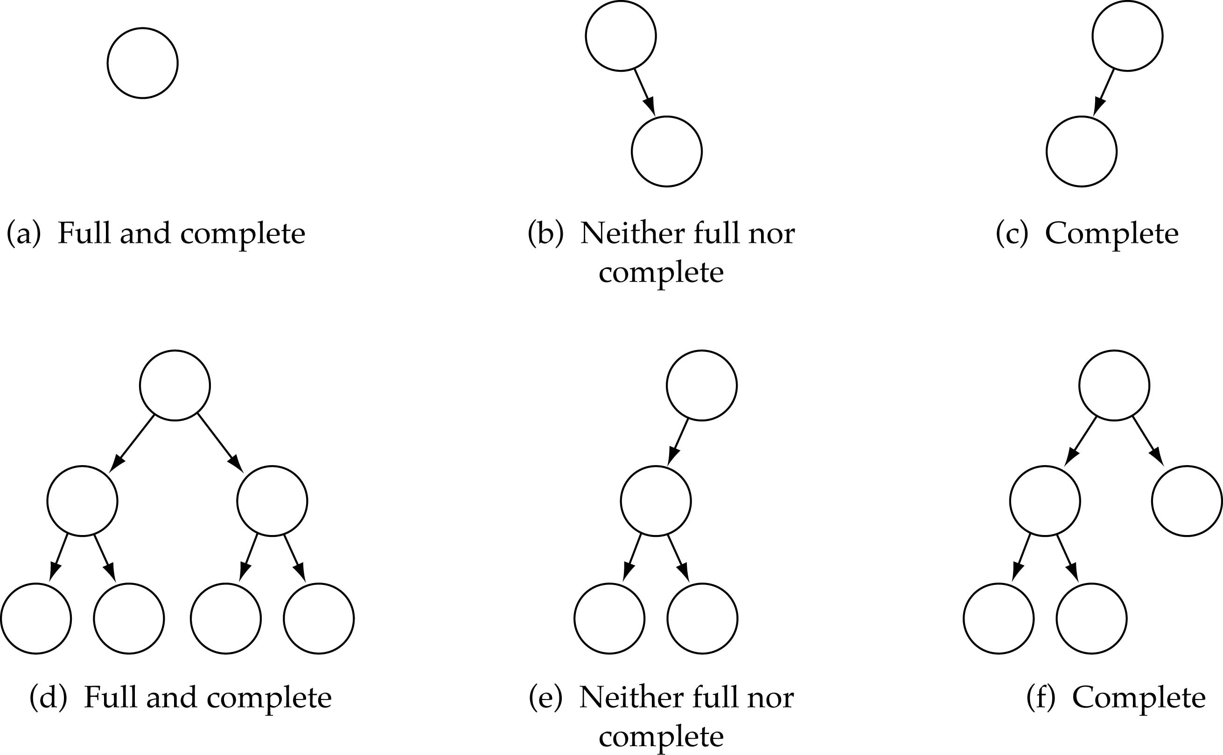
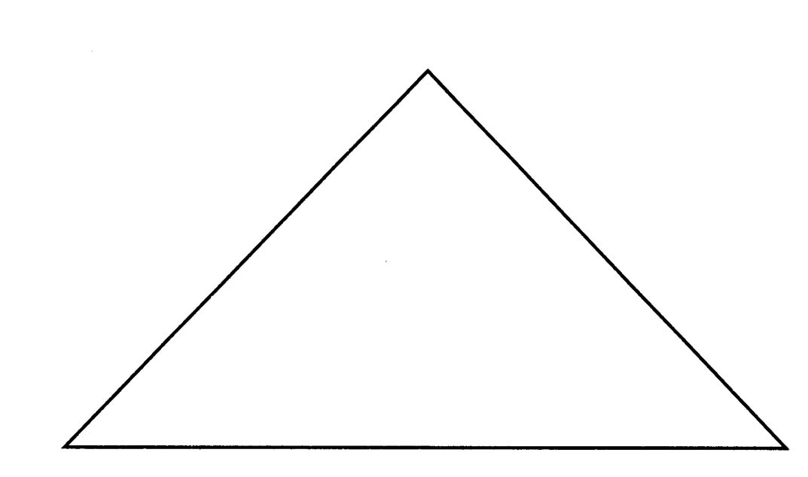
Full Binary Tree
Every non-leaf node has two children
All the leaves are on the same level
Full Binary Tree

Slide 3
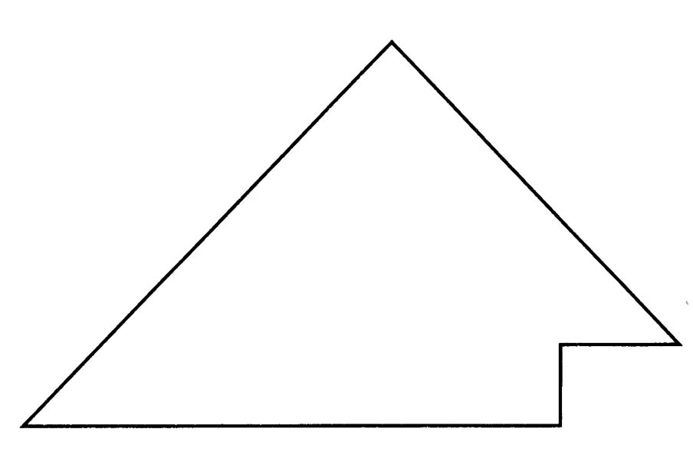
Complete Binary Tree
(1) A binary tree that is either full or full through the next-to-last level
(2) The last level is full from left to right (i.e., leaves are as far to the left as possible)
Complete Binary Tree

Slide 4
What is a heap?
A heap is a binary tree T that stores a key-element pairs at its internal nodes
It satisfies two properties:
MinHeap:
key(parent) ≤ key(child)
MaxHeap:
key(parent) ≥ key(child)
All levels are full, except the last one, which is left-filled

Slide 5
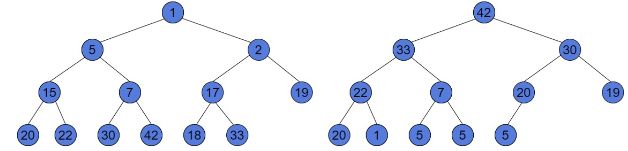
Heaps
The Heap to the left is a Min-Heap. The smallest value has the root of the tree. And, for every node, all the values under it are greater than the node.
The tree to the right is a Max-Heap. We may notice, it has duplicate values. However, this tree satisfies all the Max-Heap properties. This is a complete tree and every subtree contains values less or equal than its root node.

Slide 6
Heap and BST
The main difference is that Binary Search Tree doesn’t allow duplicates, however, the Heap does.
The BST is ordered, but the Heap is not
14
10
16
8
11
15

Slide 7
Heaps
A heap is a certain kind of complete binary tree.
Notes:
A heap is a data structure with several applications, including a way to implement Priority Queues, as shown in Chapter 11. The definition of a heap is a special kind of complete binary tree.
You probably recall that a complete binary tree requires that its nodes are added in a particular order...

Slide 8
Heaps
Root
A heap is a certain kind of complete binary tree.
When a complete
binary tree is built,
its first node must be
the root.
Notes:
The first node of a complete binary tree is always the root...

Slide 9
Heaps
Complete binary tree.
Left child
of the
root
The second node is
always the left child
of the root.
Notes:
...the second node is always the left child of the root...

Slide 10
Heaps
Complete binary tree.
Right child
of the
root
The third node is
always the right child
of the root.
Notes:
...then the right child of the root...

Slide 11
Heaps
Complete binary tree.
The next nodes
always fill the next
level from left-to-right.
Notes:
...and so on. The nodes always fill each level from left-to-right...

Slide 12
Heaps
Complete binary tree.
The next nodes
always fill the next
level from left-to-right.
Notes:
...from left-to-right...

Slide 13
Heaps
Complete binary tree.
The next nodes
always fill the next
level from left-to-right.
Notes:
...from left-to-right...

Slide 14
Heaps
Complete binary tree.
The next nodes
always fill the next
level from left-to-right.
Notes:
...from left-to-right...

Slide 15
Heaps
Complete binary tree.
Notes:
...and when a level is filled you start the next level at the left.

Slide 16
Heaps
45
A heap is a certain kind of complete binary tree.
35
23
27
21
22
4
19
Each node in a heap
contains a key that
can be compared to
other nodes' keys.
Notes:
So, a heap is a complete binary tree. Each node in a heap contains a key, and these keys must be organized in a particular manner. Notice that this is not a binary search tree, but the keys do follow some semblance of order.
Can you see what rule is being enforced here?

Slide 17
Heaps
45
A heap is a certain kind of complete binary tree.
35
23
27
21
22
4
19
The "heap property"
requires that each
node's key is >= the
keys of its children
Notes:
The heap property requires that each node's key is >= to the keys of its children.
This is a handy property because the biggest node is always at the top. Because of this, a heap can easily implement a priority queue (where we need quick access to the highest priority item).

Slide 18
Adding a Node to a Heap
45
Put the new node in the next available spot.
Push the new node upward, swapping with its parent until the new node reaches an acceptable location.
35
23
27
21
22
4
19
42
Notes:
We can add new elements to a heap whenever we like. Because the heap is a complete binary search tree, we must add the new element at the next available location, filling in the levels from left-to-right.
In this example, I have just added the new element with a key of 42.
Of course, we now have a problem: The heap property is no longer valid. The 42 is bigger than its parent 27.
To fix the problem, we will push the new node upwards until it reaches an acceptable location.

Slide 19
Adding a Node to a Heap
45
Put the new node in the next available spot.
Push the new node upward, swapping with its parent until the new node reaches an acceptable location.
35
23
42
21
22
4
19
27
Notes:
Here we have pushed the 42 upward one level, swapping it with its smaller parent 27.
We can't stop here though, because the parent 35 is still smaller than the new node 42.

Slide 20
Adding a Node to a Heap
45
Put the new node in the next available spot.
Push the new node upward, swapping with its parent until the new node reaches an acceptable location.
42
23
35
21
22
4
19
27
Notes:
Can we stop now? Yes, because the 42 is less than or equal to its parent.

Slide 21
Adding a Node to a Heap
45
The parent has a key that is >= new node, or
The node reaches the root.
The process of pushing the new node upward is called reheapification upward.
42
23
35
21
22
4
19
27
Notes:
In general, there are two conditions that can stop the pushing upward:
1. We reach a spot where the parent is >= the new node, or
2. We reach the root.
This process is called reheapification upward (I didn't just make up that name, really).

Slide 22
Removing the Top of a Heap
45
Move the last node onto the root.
42
23
35
21
22
4
19
27
Notes:
We can also remove the top node from a heap. The first step of the removal is to move the last node of the tree onto the root. In this example we move the 27 onto the root.

Slide 23
Removing the Top of a Heap
27
Move the last node onto the root.
42
23
35
21
22
4
19
Notes:
Now the 27 is on top of the heap, and the original root (45) is no longer around. But the heap property is once again violated.

Slide 24
Removing the Top of a Heap
27
Move the last node onto the root.
Push the out-of-place node downward, swapping with its larger child until the new node reaches an acceptable location.
42
23
35
21
22
4
19
Notes:
We'll fix the problem by pushing the out-of-place node downward. Perhaps you can guess what the downward pushing is called....reheapification downward.

Slide 25
Removing the Top of a Heap
42
Move the last node onto the root.
Push the out-of-place node downward, swapping with its larger child until the new node reaches an acceptable location.
27
23
35
21
22
4
19
Notes:
When we push a node downward it is important to swap it with its largest child. (Otherwise we are creating extra problems by placing the smaller child on top of the larger child.) This is what the tree looks like after one swap.
Should I continue with the reheapification downward?

Slide 26
Removing the Top of a Heap
42
Move the last node onto the root.
Push the out-of-place node downward, swapping with its larger child until the new node reaches an acceptable location.
35
23
27
21
22
4
19
Notes:
Yes, I swap again, and now the 27 is in an acceptable location.

Slide 27
Removing the Top of a Heap
42
The children all have keys <= the out-of-place node, or
The node reaches the leaf.
The process of pushing the new node downward is called reheapification downward.
35
23
27
21
22
4
19
Notes:
Reheapification downward can stop under two circumstances:
1. The children all have keys that are <= the out-of-place node.
2. The out-of-place node reaches a leaf.

Slide 28
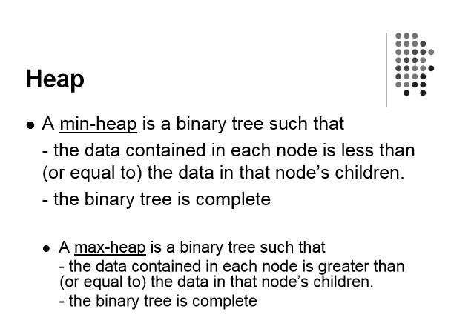

Slide 29
Implementing a Heap
42
We will store the data from the nodes in a partially-filled array.
35
23
27
21
An array of data
Notes:
This slide shows the typical way that a heap is implemented. For the most part, there is nothing new here, because you already know how to implement a complete binary tree using a partially-filled array. That is what we are doing with the heap.

Slide 30
Implementing a Heap
42
Data from the root goes in the first location of the array.
35
23
27
21
42
An array of data
Notes:
Following the usual technique for implementing a complete binary tree, the data from the root is stored in the first entry of the array.

Slide 31
Implementing a Heap
42
Data from the next row goes in the next two array locations.
35
23
27
21
42
35
23
An array of data
Notes:
The next two nodes go in the next two locations of the array.

Slide 32
Implementing a Heap
42
Data from the next row goes in the next two array locations.
35
23
27
21
42
35
23
27
21
An array of data
Notes:
and so on.

Slide 33
Implementing a Heap
42
Data from the next row goes in the next two array locations.
35
23
27
21
42
35
23
27
21
An array of data
We don't care what's in
this part of the array.
Notes:
As with any partially-filled array, we are only concerned with the front part of the array. If the tree has five nodes, then we are only concerned with the entries in the first five components of the array.

Slide 34
Important Points about the Implementation
42
The links between the tree's nodes are not actually stored as pointers, or in any other way.
The only way we "know" that "the array is a tree" is from the way we manipulate the data.
35
23
27
21
42
35
23
27
21
An array of data
Notes:
With this implementation of a heap, there are no pointers. The only way that we know that the array is a heap is the manner in which we manipulate it.

Slide 35
Important Points about the Implementation
42
If you know the index of a node, then it is easy to figure out the indexes of that node's parent and children.
35
23
27
21
42
35
23
27
21
[1] [2] [3] [4] [5]
Notes:
The manipulations are the same manipulations that you've used for a complete binary tree, making it easy to compute the index where various nodes are stored.

Slide 36
53
44
25
15
21
13
18
3
12
5
7
 | 53 | 44 | 25 | 15 | 21 | 13 | 18 | 3 | 12 | 5 | 7
0 1 2 3 4 5 6 7 8 9 10 11
For any node i, the following formulas apply:
The index of its parent = i / 2
Index of left child = 2 * i
Index of right child = 2 * i + 1

Slide 37
Heap Sort
The heapsort algorithm consists of two phases: - build a heap from an arbitrary array - use the heap to sort the data
To sort the elements in the decreasing order, use a min heap
To sort the elements in the increasing order, use a max heap
19
12
16
1
4
7

Slide 38
Example of Heap Sort
Take out biggest
19
12
16
Move the last element
to the root
1
4
7
Sorted:
Array A
12
16
1
4
7
19

Slide 39
7
swap
HEAPIFY()
12
16
1
4
Sorted:
Array A
7
12
16
1
4
19

Slide 40
16
12
7
1
4
Sorted:
Array A
16
12
7
1
4
19

Slide 41
Take out biggest
16
Move the last element
to the root
12
7
1
4
Sorted:
Array A
12
7
1
4
16
19

Slide 42
4
12
7
1
Sorted:
Array A
4
12
7
1
16
19

Slide 43
swap
4
HEAPIFY()
12
7
1
Sorted:
Array A
4
12
7
1
16
19

Slide 44
12
4
7
1
Sorted:
Array A
12
4
7
1
16
19

Slide 45
Take out biggest
12
Move the last
element to the
root
4
7
1
Sorted:
Array A
4
7
1
12
16
19

Slide 46
1
swap
4
7
Sorted:
Array A
1
4
7
12
16
19

Slide 47
7
4
1
Sorted:
Array A
7
4
1
12
16
19

Slide 48
Take out biggest
7
Move the last
element to the
root
4
1
Sorted:
Array A
1
4
7
12
16
19

Slide 49
swap
1
HEAPIFY()
4
Sorted:
Array A
4
1
7
12
16
19

Slide 50
Take out biggest
Move the last
element to the
root
4
1
Sorted:
Array A
1
4
7
12
16
19

Slide 51
Take out biggest
1
Sorted:
Array A
1
4
7
12
16
19

Slide 52
Sorted:
1
4
7
12
16
19

